Slide 1
Module 6 – Regular Expressions
6: Regular Expressions
7: Data Storage and File Handling
8: Functions

Slide 2
By the end of this chapter, you will be able to:
Understand and use Regular Expressions.
Use a range of core character classes including:
Line Anchors
Single character classes
Quantifiers
Capturing groups and back references
Alternation and non-capturing groups
Use functions from the re module to:
Match and validate strings.
Match and substitute strings.
Precompile patterns for improved performance.
Notes:
This chapter introduces

Slide 3

Regular expressions
What are they?
A string of text with special meta-characters to help match, replace, or validate text.
Often called a Regex pattern or just pattern.
Where are they used?
Search engines, databases, SQL, word processors, and text editors.
Web form validation.
Command line tools such as grep, sed, awk, and vim.
Programming languages such as C, C++, Java, JavaScript, Perl, and Python.
Types of Regex
Two dialects defined in POSIX standard:
B.R.E - Basic Regex
E.R.E - Extended Regex
Python supports both and many extensions.
Notes:
Regular expressions aren’t a programming language—they're simply a set of characters and symbols used to find patterns in text. It sounds simple, but they can be incredibly powerful once you understand how they work. Their roots actually go back to neuroscience. In 1943, McCulloch and Pitts described how the human nervous system worked, and in 1951, Stephen Kleene introduced regular sets using algebraic notation to represent these networks—coining the term regular expressions.
In 1968, Ken Thompson, creator of UNIX, updated the QED text editor to support string pattern matching, which laid the foundation for tools like ed, ex, and eventually vi. Thompson also created grep, short for g/re/p, meaning "globally search for a regular expression and print.“
Over time, tools like egrep, awk, and later programming languages like Perl embraced and extended regex capabilities. As variations emerged, a standard was needed, leading to the POSIX specification in 1986. Today, most programming languages include regular expression support, either built-in or through libraries.
Although regular expressions can seem cryptic at first (unless you’re a well-trained cat), they are an invaluable skill for any developer working with text or data.

Slide 4
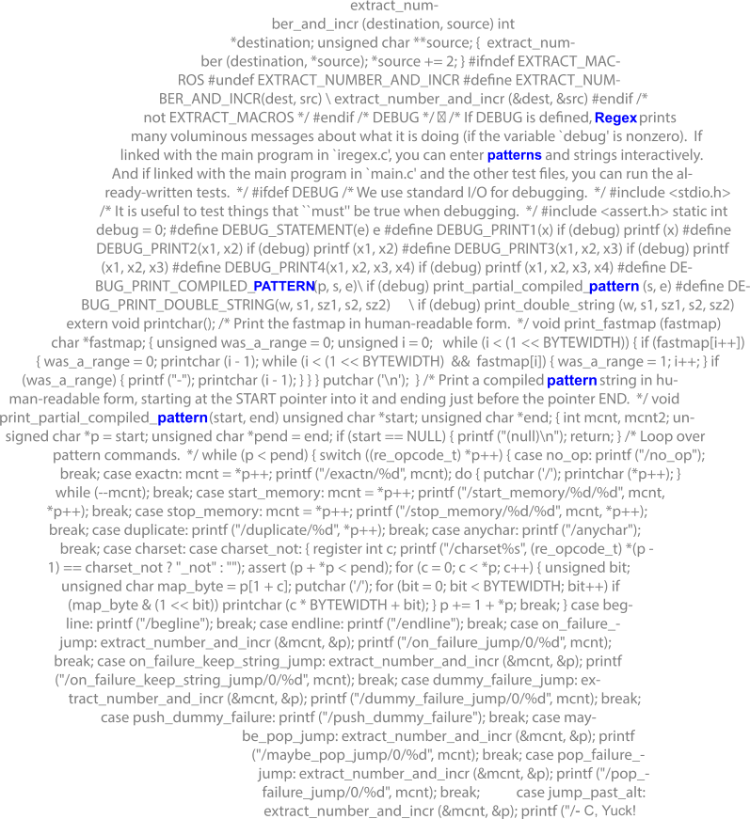
Python regular expressions
Supports Extended Regular expressions - with extensions
Requires the re module (in the standard library).
Notable features:
Can pre-compile an expression for performance.
Support Multi-line pattern matches.
Powerful substitution.
Replace a pattern using a variable-expression.
Create self-referencing patterns.
Match part of a pattern with result of previous sub-pattern.
BUT - Python string methods are powerful and fast
Don't use REs when functions or methods will do.
Notes:
Python supports Extended Regular Expressions (E.R.E.) through the re module in the Standard Library, along with several powerful extensions. While Python uses E.R.E. syntax, those familiar with tools like grep, vi, sed, and awk should find it relatively easy to pick up. One key difference is that Basic Regular Expressions (B.R.E.) require backslashes to escape braces (quantifiers) and parentheses (grouping), whereas in E.R.E. and Python, this is not necessary.
How Python Regular Expressions Compare to grep, sed, and awk:
Multiline matching: Python allows patterns to span multiple lines, enabling complex searches without manually managing line state.
Dynamic substitution: Python’s substitution supports using variables, including list or dictionary lookups based on captured groups in the match.
Function-based replacements: You can replace matched text with the result of a function call, giving you highly flexible transformations.
Self-referencing patterns: Python allows matching patterns where parts of the match refer back to earlier groups—such as matching a line that starts and ends with the same word or phrase.
Keep in mind that compiling and searching with Regex expressions incurs a performance cost. For simple tasks, it may be faster and more readable to use built-in string operators like ==, !=, in, or methods like .startswith() and .endswith().

Slide 5
Core Character Classes I
Line Anchors
Start
End
Escape Char Class
Usual
Alternative
Single Char Class
Any 1 char
Any 4 chars
Char set
Char ranges
Char ranges
NOT Char
Multiple sets
Quantifiers
0 or more
0 or once
1 or more
Exact
Min, max
At least
At most
"^the"
"^.ing$"
":[0-9]*:"
"ing$"
"^....$"
":[0-9]?:"
"^[rdz]ing$"
":[0-9]+:"
r"\."
"^[A-Z]ing$"
":[0-9]{10}:"
"[.]"
"^[a-zA-Z]ing$"
":[0-9]{10,20}:"
"^[^dz]ing$"
":[0-9]{10,}:"
":[0-9]{0,10}:"
"[aeiou][aeiou][aeiou][aeiou]"
Notes:
The examples above highlight some of the most common regular expression meta-characters—a great starting point for beginners.
Line Anchors
Use ^ to match the start of a string and $ for the end. Similar functionality exists in Python string methods.
Character Classes
. matches any single character (usually Unicode).
[ ] defines a character set (e.g., [aeiou]), and [^ ] negates it (e.g., [^0-9]).
Use ranges like [a-z] (must be in increasing order).
Escape special characters with \ or use them inside [ ] (except ^ and -, which have special roles).
Quantifiers
? = 0 or 1 occurrence
* = 0 or more
+ = 1 or more
{n} = exactly n times, {n,m} = between n and m, {n,} = n or more
Regex is greedy by default—it matches the longest possible string.

Slide 6

Core Character Classes II
Capturing groups/back references
Match 5 char palindromes
Match strings start/end with same capital
Alternation (OR)
Alternation plus non-capturing groups
Faster, no back references, just for alternation
Will match the following strings:
"eric|graham|michael|terry|john"
c i v i c
r o t o r
m a d a m
"a (?:bottle|glass|keg) of (?:lager|wine|beer)"
G1
G2
"^(.)(.).\2\1$"
"a bottle of lager"
T E L N E T
"a glass of wine"
"^([A-Z]).*\1$"
"a bottle of beer"
Notes:
This slide introduces some additional powerful features of extended regular expressions.
The alternation operator (|) matches one of several options:
For example: eric|graham|michael|terry|john.
Parentheses (()) group parts of a pattern. This allows:
Repetition using quantifiers (e.g., (ab)+)
Restricting alternation to part of a pattern (e.g., a glass of (wine|beer))
Backreferences allow you to match the same text as an earlier capture group:
Example: ^([A-Z]).*\1$
^ = start of string
([A-Z]) = capture a capital letter
.* = any characters
\1 = match the same capital as before
$ = end of string
This pattern matches strings that start and end with the same capital letter—useful in detecting simple palindromes.
Non-capturing groups use (?: ) to group without saving the match:
Example: ‘a (?:bottle|glass|keg) of (?:lager|wine|beer)’
This is more efficient when you don't need to reference the groups later

Slide 7





Often used for validating data
What would these match?
1.
2.
3.
4.
5.
"[A-Za-z0-9._%+-]+@[A-Za-z0-9.-]+\.[A-Za-z]{2,}"
"07[0-9]{9}"
"[0-3][0-9]/[0-1][0-9]/[0-9]{4}"
"£[0-9]+(\.[0-9]{2})?"
"https?://[A-Za-z0-9.-]+\.[A-Za-z]{2,}"
Notes:
Regular expressions are often used for validating data and input.
For example, the examples on the slides are used to validate:
Match an email like string, for example, info@qa.com
UK Mobile Number, for example, 07123456789
A Date in UK format, for example, 25/12/2030
A Price with a currency, and pounds and pence, for example, £18.50
A simple URL, for example, http://qa.com and https://qa.com

Slide 8
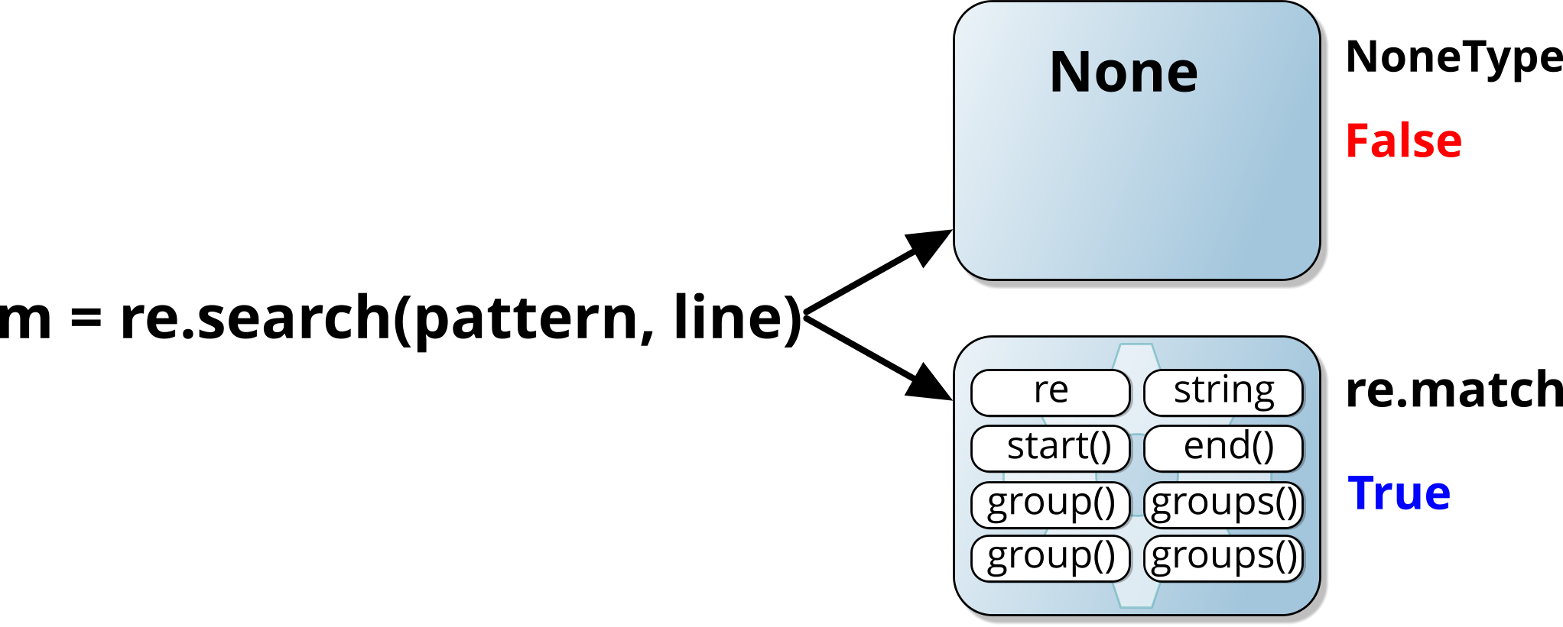
re Match Object
Module re provides several functions
For searching, matching and validation
search()
match()
fullmatch()
Precompiled using compile()
Returns:
None (False) or re.match (True) object
Exception re.error on failure
Match object provides several methods:
testy = "The quick brown fox jumps over the lazy dog"
m = re.search(r"(quick|slow).*(fox|camel)", testy)
if m:
print(f"Matched {m.groups()} between {m.start()} and {m.end()}")
Matched ('quick', 'fox') between 4 and 19
Notes:
Importing the re module makes the regular expression functions available, with search() and match() being the most common, and fullmatch() (added in Python 3.4) used when the entire string must match. Each of these functions returns either a MatchObject or None. A MatchObject evaluates as True in a Boolean context, while None evaluates as False. If the regex itself is invalid, Python raises a re.error exception (improved in Python 3.5).
Capturing groups are created with parentheses (). The text inside a group can be referenced later in the pattern using a back-reference such as \1. From the MatchObject, groups can be accessed with m.group(n) for an individual group, or m.groups() to return a tuple of all captured groups. Calling m.group() without a parameter returns the full matched string.
Other useful methods include start() and end(), which give the start and end positions of the match in the input string. The MatchObject also provides attributes such as string (the original input) and re (the compiled regex used).For efficiency, regular expressions can be pre-compiled with re.compile().

Slide 9
re Substitution
Module re provides several functions
For search and substitution
Returns a modified string
sub(pattern, replacement, string[, count, flags])
Returns a tuple of (modified string, num of changes)
subn(pattern, replacement, string[, count, flags])
Optional count determines occurrence to modify
Precompiled using compile()
line = "Perl for Perl Programmers"
cs, num = re.subn("Perl", "Python", line)
if num: print(cs)
cs, num = re.subn("Perl", "Python", line, 1)
if num: print(cs)
Python for Python Programmers
Python for Perl Programmers
Notes:
The re.sub() function performs substitution in a string, similar in spirit to the awk scripting language. It returns the modified string after replacing all matches of the pattern. A related function, re.subn(), does the same but also returns the number of substitutions as part of a tuple. Both functions apply substitutions globally, scanning the string from left to right.
Another useful regex function is split(), which you will see on the next slide.
Regular expressions can also be compiled into a RegexObject using re.compile(). Compiling a pattern is more efficient when the same regex is used repeatedly, such as inside a loop. Once compiled, the object provides methods like match(), fullmatch(), findall(), search(), split(), sub(), and subn() to work with the text directly.

Slide 10
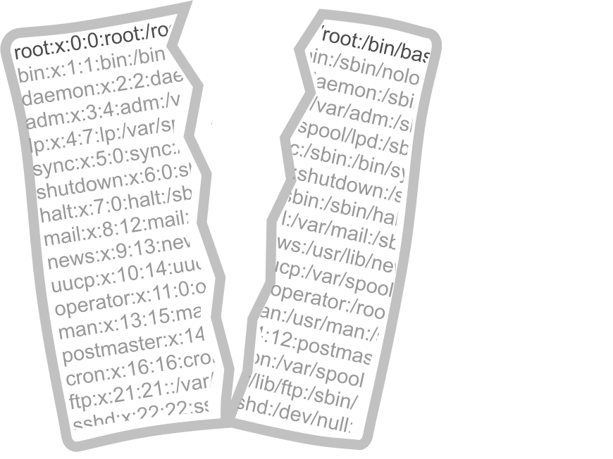
re Split
Similar in functionality to str.split()
Uses a RE for the separator instead of a string
re.split(pattern, string[, max_splits=0, flags=0])
Default for max_splits is zero which is unlimited
Only use the re version if you need alternative separators
String version is more efficient
import re
line = "root:;0.0:superuser,/root;/bin/bash"
elems = re.split('[:;.,]', line)
print(elems)
['root', '', '0', '0', 'superuser', '/root', '/bin/bash']
Notes:
Python string objects provide a built-in split() method, which splits a string using a specified delimiter and returns a list of substrings. This is often useful when processing lines of text from a file. While strings in Python are immutable, the resulting list is mutable, meaning it can be modified and later joined back into a string with the join() method.
The re module extends this functionality with re.split(), which allows a regular expression to define the delimiter. This makes it much more flexible, similar to the split functions in languages like Perl and PHP. For example, re.split(r'[:;.,]', text) will split a string using any of the characters : ; . , as delimiters. An optional argument lets you specify the maximum number of splits to perform.
From Python 3.1, re.split() also accepts a flags parameter, which can modify how the pattern is applied - for instance, using re.IGNORECASE to make splitting case-insensitive.

Slide 11
Shorthand Character Classes
A character class describes a set of characters
For example, [a-z], [^A-Z], and [aeiou]
Python also supports several shorthand character classes.
Preferred, concise, portable and easier to read
Class | Shortcut | Class | Shortcut
Digit | \d | Not Digit | \D
Word Char | \w | Not Word Char | \W
Whitespace | \s | Not Whitespace | \S
Word Boundary | \b | Not Word Boundary | \B
Start of Line | \A | End of Line | \Z
m = re.search(r'^ttyp\d$', port)
if m:
print(port)
ttyp0
ttyp9
Notes:
Python’s re module supports the same single-character classes and sets familiar from BRE (Basic Regular Expressions) and tools like sed and awk.
In addition, Python provides shorthand character classes using escape sequences:
\d → digit
\s → whitespace
\w → word character
These can also be used inside character sets.
Example: [\da-fA-F] matches a hexadecimal digit.
Limitations: As of Python 3.13.1, the re module does not support POSIX character classes (e.g., [:digit:], [:space:], [:alnum:]).
Python also introduces an additional shorthand, \g, for referencing named groups, which will be discussed later. Shorthand classes are often preferred over POSIX forms because they are more concise, portable across tools, and easier to read.

Slide 12

Example – anchors
The ^ and $ Indicate start or end of text
Only when used at start or end of pattern
Shortcuts \b matches a word-boundary and \B not a word-boundary:
name, old, new = sys.argv[1:]
new_name = re.sub(fr"\.{old}$", f".{new}", name)
print(f"Renaming {name} to {new_name}")
os.rename(name, new_name)
Renaming archive.1 to archive.2
txt = 'Stranger in a strange land'
m = re.search(r'range\b', txt)
print(m.start())
txt = 'Stranger in a strange land'
m = re.search(r'range\B', txt)
print(m.start())
16
2
Notes:
Anchors are special tokens in regex that match positions in the text rather than actual characters. The $ anchor, for example, matches the end of a line or the end of the string. If you write 00$, it will match two zeroes at the end of the text, or two zeroes followed by a newline at the end of a line.
The ^ anchor matches the start of a string. When used anywhere other than the beginning of a pattern, however, ^ loses its special meaning and simply represents a literal caret character.
By default, ^ and $ apply to the start and end of the entire text. If the multiline flag (re.M) is used, they instead apply to the start and end of each individual line. To force a true start-of-text or end-of-text match in any case, you can use \A for the beginning and \Z for the end.
Regex also provides word boundary anchors. The token \b matches a word boundary (the position between a word character and a non-word character), without consuming any characters. Its opposite, \B, matches positions where no word boundary occurs, allowing you to find text embedded inside words. Be aware that the behaviour of \b with punctuation like apostrophes can sometimes be unintuitive. One important caveat: inside a character class ([...]), \b does not mean a word boundary - it represents a backspace character instead.

Slide 13

Example – matching alternatives
The | character separates alternative words or patterns
Use parentheses to group alternatives
Required with text before or following alternatives
drink = 'A glass of Glenfiddich'
if re.search(r’Glenfiddich|Lagavulin|Talisker', drink):
print("It's a Scottish Whisky!")
pattern = r'A (glass|bottle|barrel) of (Irn Bru|Buckfast|Glenfiddich)'
if re.search(pattern, drink):
print("This drink is suitable for the Scots!")
Notes:
The first example on the slide matches three possible patterns in the text; in this case, it successfully matches Glenfiddich (a good choice) and causes the if statement to evaluate to True. The second example expands this idea, allowing for nine different possible matches.
An important side effect of using parentheses for grouping is that the matched text is automatically captured in groups, which can then be extracted and reused - a feature we will explore later.

Slide 14
Example – repeat quantifiers
Quantifier characters repeat the preceding pattern
Greedy Vs Lazy
Repetition | Char | Example | Comment
0 or once | ? | [+-]? | Optional sign
0 or many | * | [0-9]* | 0 or more digits
1 or many | \+ | [A-Z]+ | 1 or more uppercase chars
m = re.search(r"[+-]?\d\d\s*\d+", line)
Optional sign, 2 digits, 0 or more whitespace, 1 or more digits
m = re.search(r"boink+", sound)
boink, boinkk, boinkkk
m = re.search(r"(boink)+", sound)
boink, boinkboink, boinkboinkboink
line = "root:x:0:0:superuser:/root:/bin/bash"
"^.*:"
root:x:0:0:superuser:/root:
"^.*?:"
root:
Notes:
The repeat quantifiers described here are greedy, meaning they consume as much of the text as possible without breaking the overall match.
For example, given the text:
line = “root:x:0:0:superuser:/root:/bin/bash”
The pattern “^.*:” will match “root:x:0:0:superuser:/root:” – the start of line all the way to the last colon.
Python also supports minimal (or lazy) quantifiers, which match the smallest amount of text necessary to satisfy the pattern. This is done by appending a question mark (?) after the repeat quantifier. For instance, with the same text, the pattern “^.*?:” will match only “root:”.

Slide 15

Example – interval quantifiers
Quantifier characters repeat the preceding pattern
Match a U.S telephone number
Start of text or a non-digit character
Followed by 3 digits followed by a hyphen
Followed by between 2 and 4 digits
Followed by an optional whitespace
Followed by between 4 and 8 digits
Followed by a non digit character or end of text
Repetition | Char | Example | Comment
exact | {3} | [0-9]{3} | 3 digits
min, max | {3,5} | \d{3,5} | Between 3 and 5 digits
at least | {5,} | [A-Z]{5,} | At least 5 uppercase chars
at most | {0,5} | [A-Z]{0,5} | Up to 5 uppercase chars
m = re.search(r"(^|\D)\d{3}-\d{2,4}\s?\d{4,8}(\D|$)", phone)
Notes:
In Python regular expressions, quantifiers control how many times the preceding character or group must appear to make a match. Interval quantifiers are written in curly braces and allow you to specify exact counts, ranges, or limits. For example, {3} matches exactly three occurrences, while {3,5} matches between three and five. Using {5,} enforces at least five repetitions, whereas {0,5} matches up to five. These quantifiers provide precise control compared to the simpler *, +, and ? operators.
The example on the slide demonstrates how these quantifiers can be combined to validate a U.S. telephone number format. The pattern begins by asserting either the start of the text or a non-digit character, followed by three digits and a hyphen. It then requires between two and four digits, an optional space, and between four and eight digits. Finally, the expression checks for either a non-digit character or the end of the text. This ensures that the match is properly bounded and does not overrun into unrelated characters.
By using interval quantifiers, Python’s re module allows fine-grained pattern control. In this case, they help define flexible but strict rules for different segments of a phone number, accommodating variations in digit groupings while still enforcing a valid overall structure.

Slide 16
Capturing Groups and back references
Python also allows substitution strings to reference groups within the pattern
This makes it possible to create self-referencing regular expressions.
Groups can be referenced by \n or \g<n>, where n is the group number
Always use a raw string to avoid conflicts with Python string escapes
Back references can also be used in the replacement string for sub() and subn()
import re
from datetime import date
year = str(date.today())[:4] # Get current year
strn = "copyright 2005-2006"
print(re.sub(r"((19|20)[0-9]{2})-((19|20)[0-9]{2})", r"\1-" + year, strn)
copyright 2005-2025
Notes:
Python allows the use of parentheses to group characters or sub-patterns into a single unit, making it possible to apply quantifiers to the entire group. This is particularly useful when working with recurring blocks of text or repeated words. Such groups are also known as capturing groups.
The contents of a capturing group can be reused later in the same regular expression through a back-reference. This is done using \1, \2, etc., which refer to the text captured by the first, second, and subsequent groups. When groups are nested, numbering is assigned according to the order in which the opening parentheses appear. It is important to use raw strings (e.g., r'\1') for back-references, as \1 by itself has a special meaning in Python strings.
Python also provides an alternative back-reference syntax: \g<1>, \g<2>, and so on. This style is associated with named capturing groups (covered later) and has the additional benefit of supporting \g<0>, which refers to the entire matched string. Note that \0 is not supported in Python’s re module. While back-references are powerful, they can make regular expressions slower to evaluate. Overuse of back-references may significantly increase processing time, so they should be applied thoughtfully and sparingly.

Slide 17
Finding multiple matches in Text
Finding all matches in a list using re.findall()
Returns a list of matches or groups
Iterating through all matches using re.finditer()
Returns an iterator to a match object
home_stuff = "/dev/sda3 135398 69683 52176 57% /home/stuff"
nums = re.findall(r"\b\d+\b", home_stuff)
print(nums)
['135398', '69683', '52176', '57']
home_stuff = "/dev/sda3 135398 69683 52176 57% /home/stuff"
for m in re.finditer(r"\b(\d+)\b", home_stuff):
print(m.group())
135398
69683
52176
57
Notes:
By default, most re methods stop after finding the first (leftmost) match. In contrast, the findall() method scans through the entire text, collecting all matches into a list.
The finditer() method works in a similar way but returns an iterator object, which can be looped over to extract each match one by one. This is particularly useful when working with repeated patterns across multiple lines.
The findall() method was introduced in Python 2.2, and since Python 3.7, both findall() and finditer() allow non-empty matches to begin immediately after a preceding empty match.

Slide 18
RE Flags
Change the behaviour of the match
Can be embedded in the RE
Can be applied to parts of the string (Modifier Spans, Py3.6)
Can be specified as an optional argument to search, match, split, sub etc.
Can be modified with ‘”|” separator
Long Name | Short | Embedded | Comment
re.IGNORCASE | re.I | (?i) | CaSe insensitive match
re.MULTILINE | re.M | (?m) | ^ and $ match start/end of line
re.DOTALL | re.S | (?s) | DOT also matches a newline
re.VERBOSE | re.X | (?x) | Whitespace is ignored for comments
m = re.search(r'(?im)^john', name)
m = re.search(r'^john', name, re.IGNORECASE|re.MULTILINE)
m = re.search(r'^(?i:j)ohn', name)
Notes:
The optional flags parameter was introduced in Python 3.1 and can be used with re methods to change how a pattern is matched. For example, re.IGNORECASE (or its shorthand re.I) makes matches case-insensitive.
It might seem that short names are simply the first letter of the long names, and that the embedded syntax is just those letters in lowercase, but this is not always true. For example, the S and X flags exist for compatibility with other regular expression engines rather than following this convention.
The examples on the slide illustrate different flag usages:
The first two combine IGNORECASE and MULTILINE, so the pattern will find “john” in any case at the start of the text or after a newline.
The third demonstrates a modifier span, where only the letter j is matched case-insensitively. This allows “John” or “john” but not “JOHN”.
When flags are embedded inside the regex, the order of the single-character modifiers does not matter. When flags are passed to re methods, they are combined using a binary OR (|), also in any order. Flags and embedded attributes can be mixed, but doing so may reduce readability. The flags, re.ASCII and re.LOCALE, are deprecated since Python 3.5) or only for byte objects.

Slide 19
Review & Lab
Answer review questions
Your instructor will guide you which lab exercises to complete

Slide 20
Review Questions
Which re method returns all non-overlapping matches of a pattern as a list?
re.match()
re.findall()
re.search()
re.finditer()
What does the regular expression r”\broot\b” match?
The substring root anywhere in the text
root only at the beginning of the text
The word root as a standalone word
Any substring containing the letters r, o, o, and t in order
Notes:
Answers on next page..

Slide 21
Review Questions
Which of the following correctly applies both the IGNORECASE and MULTILINE flags?
re.search(pattern, text, re.I + re.M)
re.search(pattern, text, re.IGNORECASE or re.MULTILINE)
re.search(pattern, text, re.I | re.M)
re.search(pattern, text, [re.I, re.M])
Which does the back-reference \1 represent in a regex pattern?
The first character of the input string
The contents of the first capturing group
A literal backslash followed by the digit 1
The number of matches found so far
Notes:
Correct answers:
Which re method returns all non-overlapping matches of a pattern as a list?
re.findall()
What does the regular expression r”\broot\b” match?
The word root as a standalone word
Explanation: The escape chars \b match a word boundary character so pattern will match a standalone word
Which of the following correctly applies both the IGNORECASE and MULTILINE flags?
re.search(pattern, text, re.I | re.M)
Explanation: Flags are separated using the | character.
4. Which of the following is true about Python’s built-in functions
The contents of the first capturing group
Explanation: The back-reference \1 tells the regex engine to match the same text that was previously captured by the first pair of parentheses in the pattern.

Slide 22
Summary
Regular Expressions are widely used across many tool and languages
In Python, regex operations return a Match Object when a match is found
Several key functions are available in the re module, including:
match() – check for a match at start of the string
search() – finds the first occurrence of a pattern
findall() – returns all matches as a list
finditer() – returns an iterator over matches
sub()/subn() – performs substitution
split() – split text using regex patterns
Regex supports a rich set of character classes:
Character classes, quantifiers, anchors, grouping, back-references and flags

